Slide 1
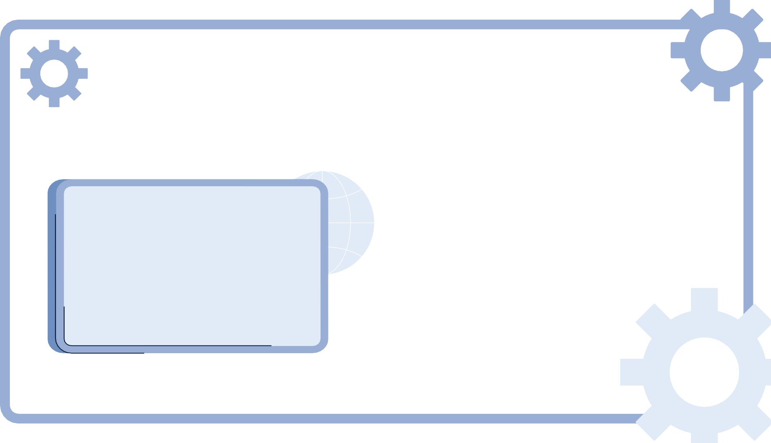

OWASP Top 10
Vulnerabilities:
Injection and Insecure Design
Daniela Tomás up202004946@edu.fc.up.pt Diogo Nunes up202007895@edu.fc.up.pt
João Veloso up202005801@edu.fc.up.pt

Slide 2










Introduction
This presentation analyzes two websites: one that highlights unsafe behaviors vulnerable to various types of cyberattacks, and another that shows safe precautions to prevent these vulnerabilities.

Slide 3
Injection (A03:2021)
Injections occur when an application sends untrusted data to an interpreter. This can trick the interpreter into executing unintended commands or accessing data without the required authorization.
Injection flaws are very prevalent, particularly in legacy code, and are often found in SQL queries, LDAP queries, XPath queries, OS commands, program arguments, etc.
Injection flaws are normally discovered when there is the ability to examine code directly, but they can also be found via testing, albeit with more difficulty. There are also tools to help discover them, such as fuzzers and scanners.

Slide 4
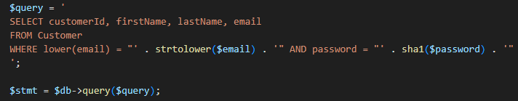
SQL Injection
Lack of Sanitization in Login

Slide 5
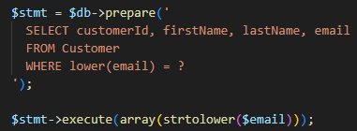
SQL Injection
Countermeasures
Use of stored procedures
Escaping all user supplied input

Slide 6
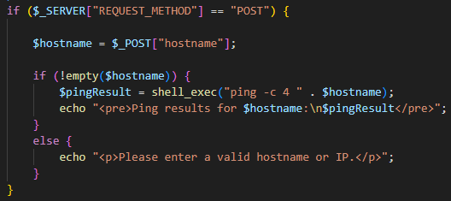
Command Injection
Lack of Sanitization in Shell Commands

Slide 7
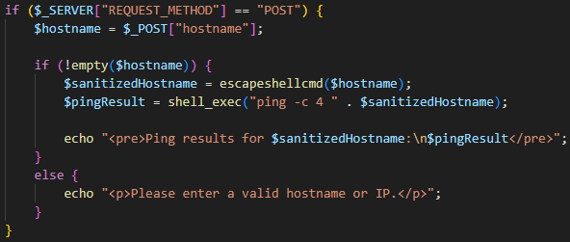
Command Injection
Countermeasures
Sanitized hostname in ping

Slide 8
Insecure Design (A04:2021)
Insecure design vulnerabilities result from inadequate system architecture or design choices that provide security flaws. Attackers take advantage of these flaws to compromise the
system’s availability, confidentiality, or integrity. Injection vulnerabilities can result from
insecure design practices.

Slide 9
Password Encryption
Weak Passoword Encryption (SHA1)
The usage of SHA1 for password encryption is considered weak due to its susceptibility to brute-force and rainbow table attacks.
In PHP, the sha1 function generates a SHA-1 hash of a string.

Slide 10
Password Encryption
Countermeasures
Stronger Password Hashing Function (bcrypt)
string password_hash (string $pwd , integer $algo [, array $opts])
boolean password_verify (string $pwd , string $hash)

Slide 11
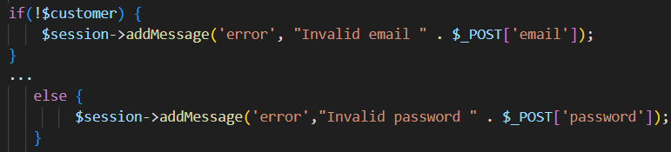
Error Messages
Detailed Error Messages

Slide 12

Error Messages
Countermeasures

Slide 13
Stock Limits
No Maximum Quantity Limited to Stock

Slide 14
Stock Limits
Countermeasures
Enforcement of (Maximum) Stock Limits

Slide 15








Conclusion
A comprehensive strategy involving strong countermeasures like input validation, prepared statements, secure hashing functions, and system exposure reduction is crucial to combat injection and insecure design flaws in web applications.

Slide 16
References
https://owasp.org/Top10/A04 2021-Insecure Design/
https://owasp.org/Top10/A03 2021-Injection/
The MITRE Corporation, Common Weakness Enumeration, “CWE-89: Improper Neutralization of Special Elements used in na SQL Command (’SQL Injection’)”. https://cwe.mitre.org/data/definitions/89.html, 2023.
The MITRE Corporation, Common Weakness Enumeration, “CWE-78: Improper Neutralization of Special Elements used in na OS Command (’OS Command Injection’)”. https://cwe.mitre.org/data/definitions/78.html, 2023.
The MITRE Corporation, Common Weakness Enumeration, “CWE-257: Storing Passwords in a Recoverable Format”. https://cwe.mitre.org/data/definitions/257.html, 2023.
The MITRE Corporation, Common Weakness Enumeration, “CWE-209: Generation of Error Message Containing Sensitive Information”. https://cwe.mitre.org/data/definitions/209.html, 2023.
https://owasp.org/www-project-top-ten/
https://sectigostore.com/blog/what-is-owasp-what-are-the-owasp-top-10- vulnerabilities/
Dafydd Stuttard and Marcus Pinto, The Web Application Hacker’s Handbook, 2nd ed, 2011.

